Slide 1


Data Analytics Project
REGIONAL MARKET ANALYSIS FOR LIFE INSUARANCE & DETERMINATION OF PREMIUM AMOUNT

Slide 2
Agenda
• Project Summary • Team Profile • Project Management Overview • Justification and Importance
• Project Execution
• Deliverables •Demo •Lessons Learned • Recommendations and Conclusion

Slide 3

PROJECT SUMMARY
Zenith Life Insurance, is our hypothetical client , who is a new and innovative entrant in the Canadian life insurance market, seeks to strategically position itself by understanding and leveraging the country's diverse demographic landscape. This project is designed to provide Zenith Life Insurance with a comprehensive analysis of demographic data across Canada, focusing on key factors such as location, age, gender, and income levels. The primary goal is to identify the most promising regions for marketing life insurance products effectively and to develop a method for calculating premium amounts using life expectancy data from Statistics Canada.
By completing this project, Zenith Life Insurance will be well-equipped to enhance its market presence and competitiveness in the Canadian life insurance industry, driving business growth and customer satisfaction.
REGIONAL MARKET ANALYSIS FOR LIFE INSUARANCE & DETERMINANTION OF PREMIUM AMOUNT

Slide 4

PROFILE
Name: Naseef Mohammed Ansaf Mohammed Thowfeek
Role: Business Intelligence Analyst
Description: Bachelor's in Business Administration & Finance
www.linkedin.com/in/naseef-mohammed

Slide 5
Introduction
Objective
The primary objective is to help Zenith Life Insurance better strategize their market penetration plans through a comprehensive, interactive dashboard and provide an intuitive method for life insurance premium calculation.
Research Questions
What are the key demographic factors influencing the demand for life insurance in different regions of Canada?
How do age, gender, income level, and location affect life insurance demand?
Which regions in Canada show the highest potential for life insurance market penetration?
How can life expectancy data be effectively used to calculate life insurance premiums?
What visualization techniques best represent the demographic data for strategic decision-making?
By addressing these research questions, the team will deliver a robust and actionable solution to Zenith Life Insurance, helping them make data-driven decisions for their market penetration strategy.

Slide 6
Scope of Project
Scope:
Analysis of Canadian demographic data to identify promising regions for marketing.
Actuarial calculations based on life expectancy data.
Development of a Power BI dashboard for data visualization.
Delivery of all necessary documentation and an executive presentation.
Out of Scope:
Any analysis beyond Canadian regions.
Data collection from sources other than specified (e.g., non-governmental).
Implementation of marketing strategies post-analysis.

Slide 7
Deliverables
Deliverables
Integrated dataset combining demographic data and life expectancy statistics.
A comprehensive, interactive dashboard with visualizations of demographic data.
Actuarial life insurance premium calculation based on Canadian life expectancy data.
A comprehensive project report and documentation.
An executive presentation highlighting major insights and demonstrating dashboard functionality.
Outcomes and Benefits
Clear visualization of demographic data in a Power BI dashboard.
Strategic insights for market penetration.
Optimized premium calculation based on life expectancy data.
Enhanced ability to target marketing efforts effectively.

Slide 8
Why This Project is Important?
Understanding demographic and regional trends allows insurance providers like Zenith Life Insurance to better align their products with customer needs. The analysis sheds light on critical factors such as:
Age and Gender Patterns: These insights help identify which demographic groups are most likely to purchase life insurance policies. For instance:
Younger demographics may be attracted to starter policies.
Older demographics may seek comprehensive coverage plans.
Income Distribution: Studying income levels ensures premium pricing is competitive yet accessible. This improves customer retention and affordability.
High-income regions can support premium policies.
Lower-income regions may benefit from tailored, cost-effective options.
Regional Preferences: Data about specific provinces or cities highlights geographical differences in insurance needs. For instance:
Urban areas may prioritize family plans.
Rural areas might focus more on basic coverage options.
By targeting these variables, Zenith can fine-tune its marketing strategies and product offerings, ensuring greater customer satisfaction and market relevance.

Slide 9
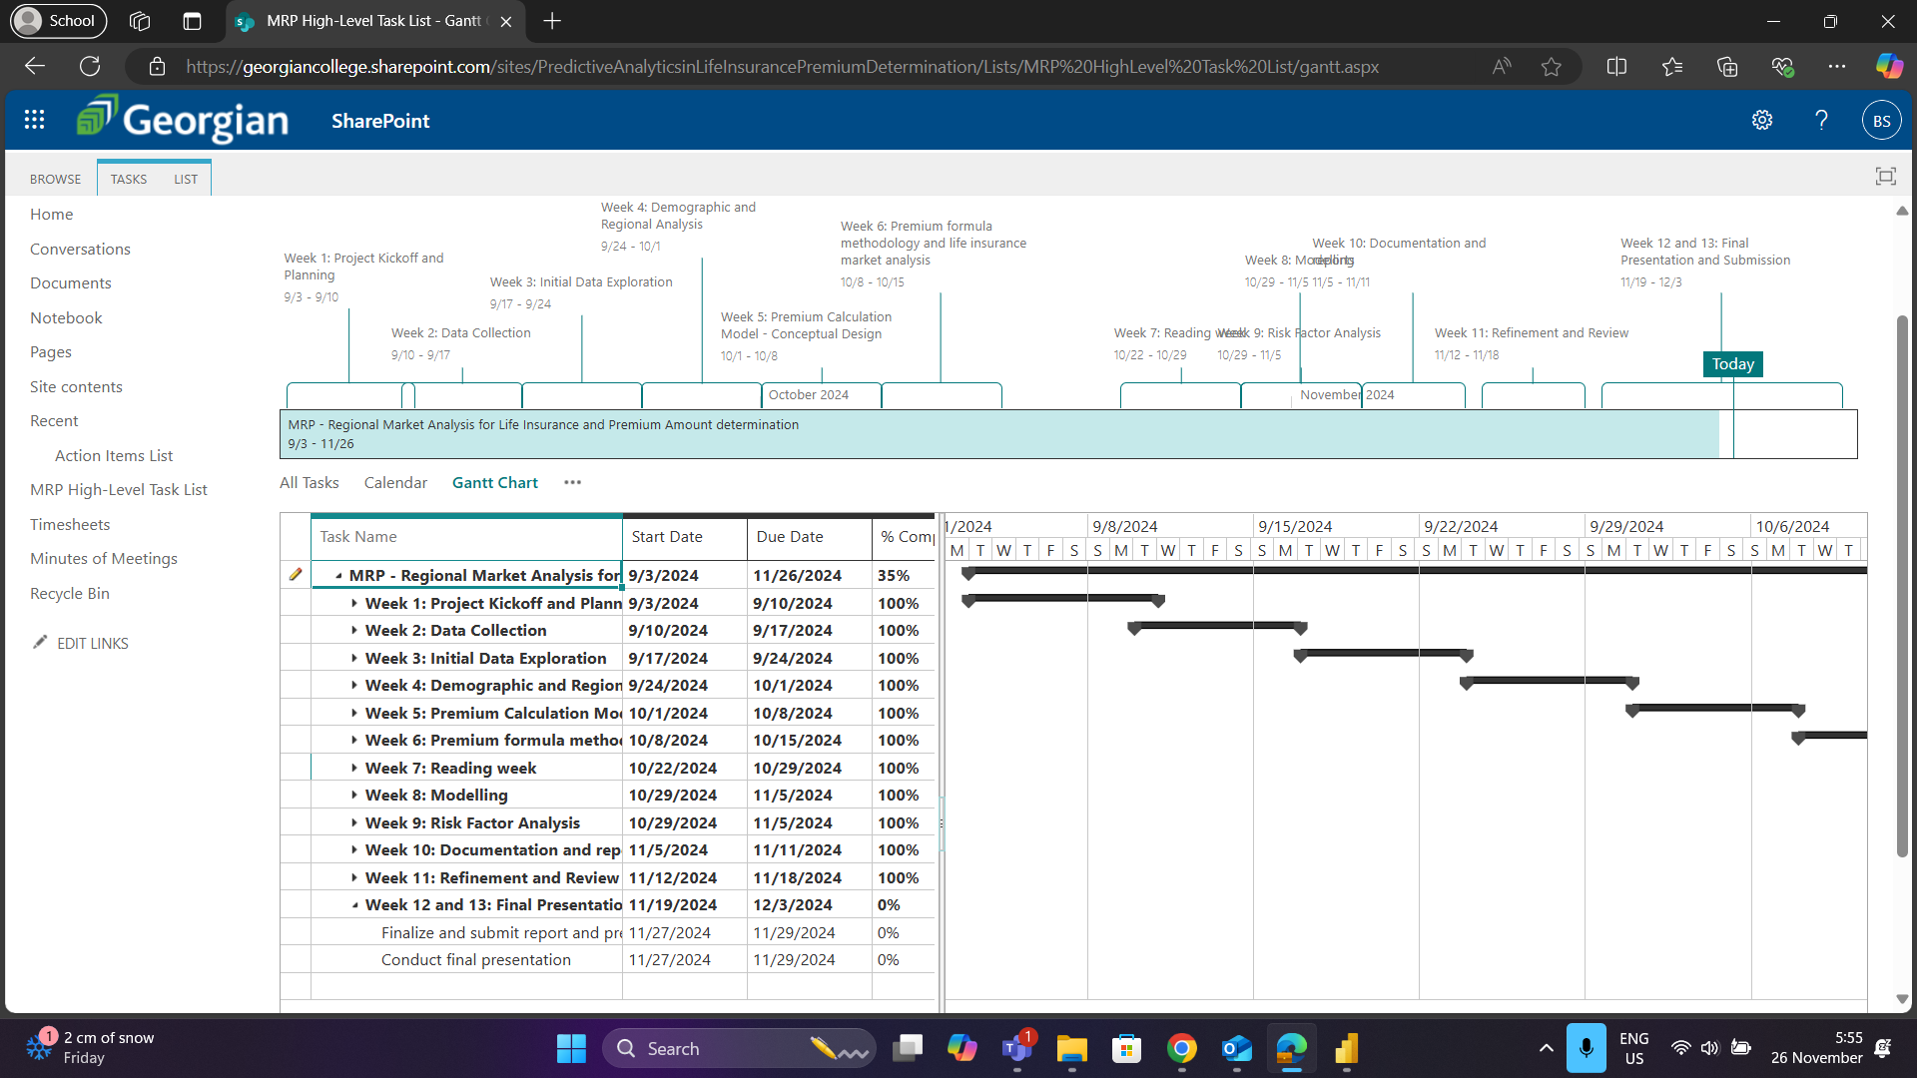
HIGH-LEVEL TIMELINE CHART (GANTT)

Slide 10
COMMUNICATION PLAN: REGIONAL MARKET ANALYSIS FOR LIFE INSURANCE
Stakeholders & Communication Strategy:
1. Sponsor
- Messages: Client meetings, risks/issues, project status, closing presentation
- Methods: In-person, MS Teams, Email
- Frequency: As needed, weekly for status reports, final presentation in-person
2. Project Manager
- Messages: Client/team meetings, risks/issues, project status, closing presentation
- Methods: In-person, MS Teams, Email
- Frequency: As needed, weekly for status reports, final presentation in-person
3. Team Members
- Messages: Client/team meetings, risks/issues, project status, closing presentation
- Methods: In-person, MS Teams, Email
- Frequency: As needed, weekly for status reports, final presentation in-person
REGIONAL MARKET ANALYSIS FOR LIFE INSUARANCE & DETERMINANTION OF PREMIUM AMOUNT

Slide 11
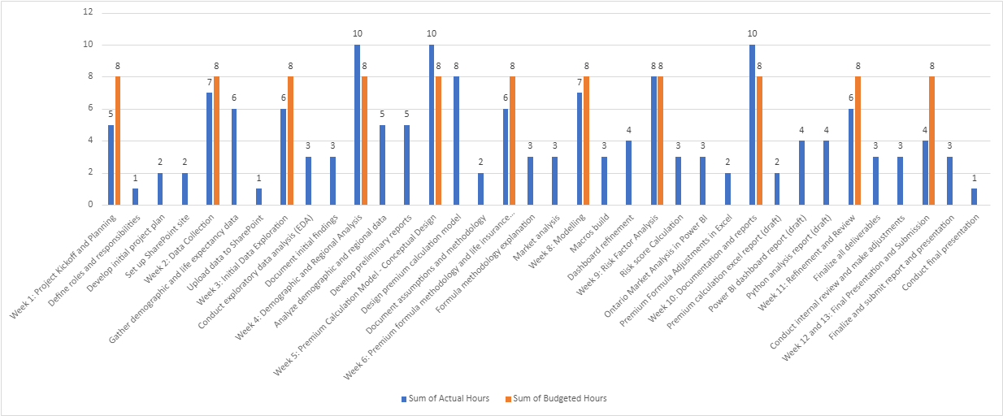
BUDGETED VS ACTUAL CONSUMPTION

Slide 12
Project Execution
Data Collection and Exploration
Analysis using Python
Premium Amount Calculation
Visualization in Power BI Dashboard
Documentation and Reporting
Preparing the data for Analysis and visualization
Analysis of Canadian demographic data to identify promising regions for marketing.
Actuarial calculations based on life expectancy data using MS Excel.
Clear visualization of demographic data in a Power BI dashboard.
Integrating the work done into a final report

Slide 13
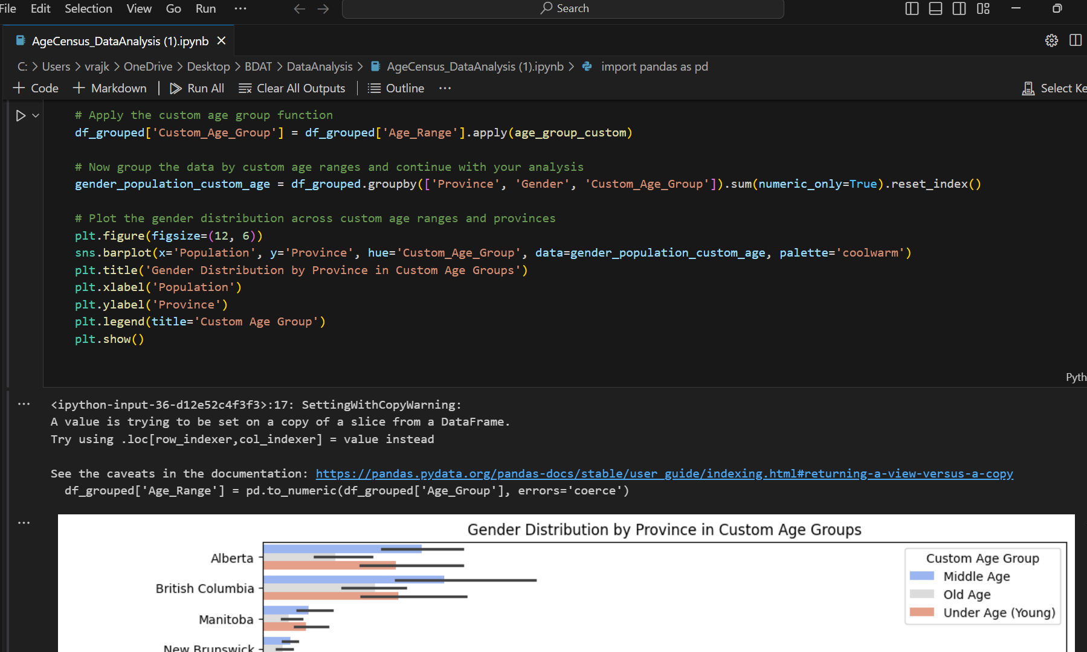
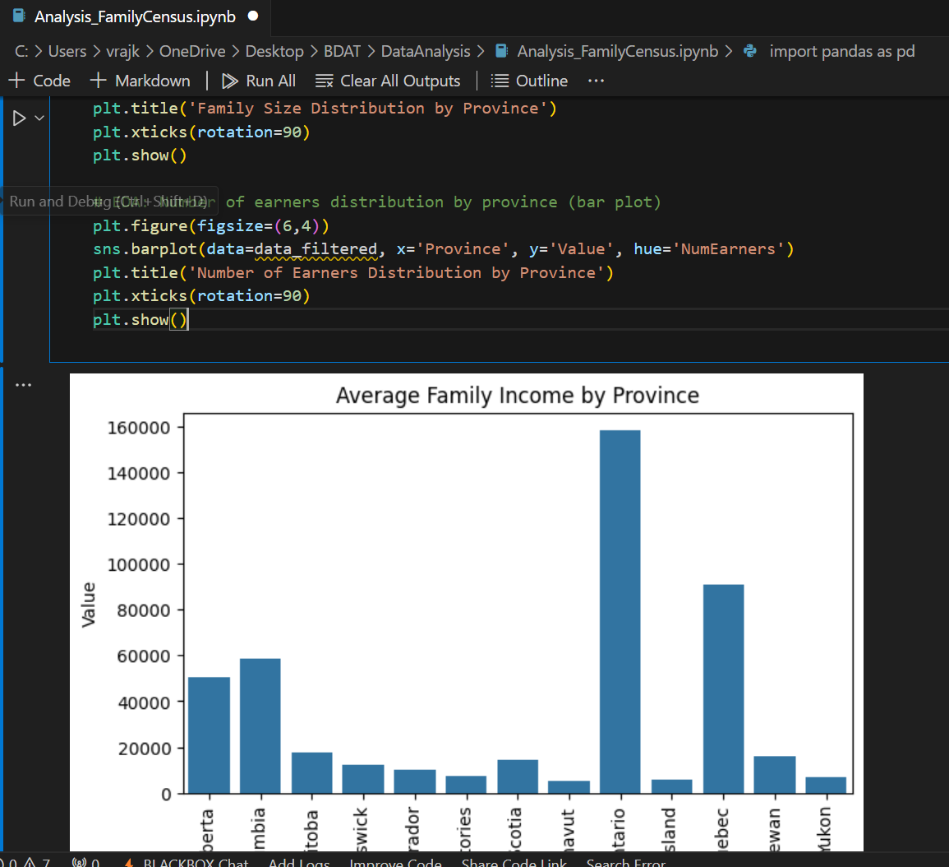
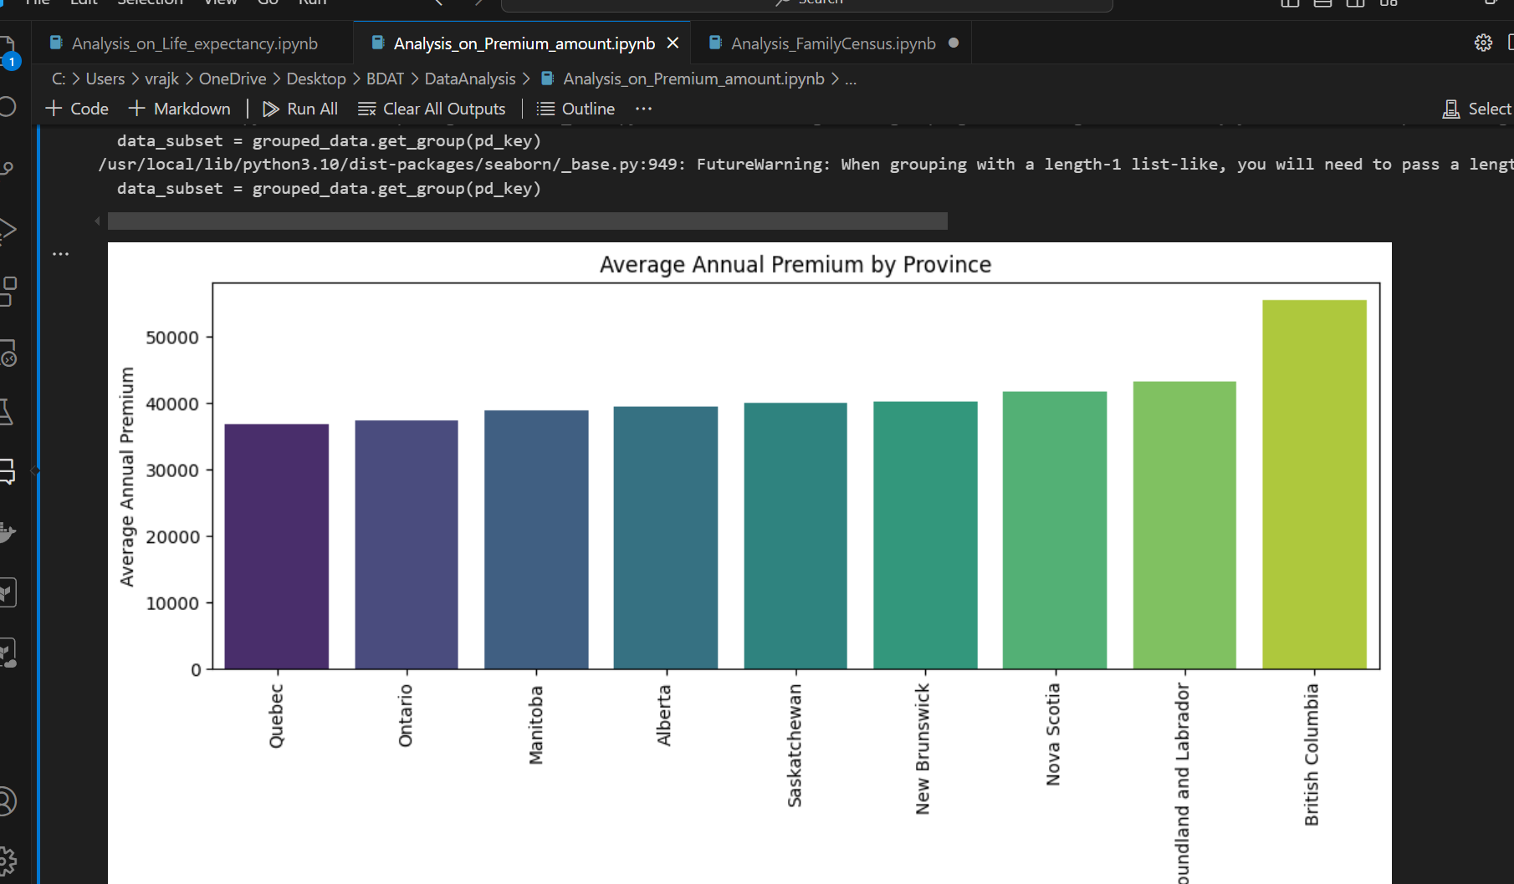
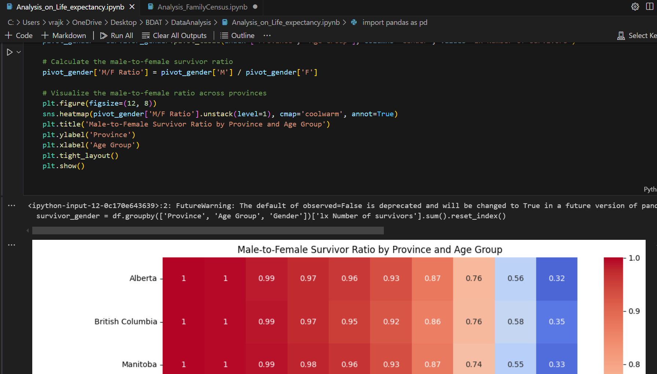
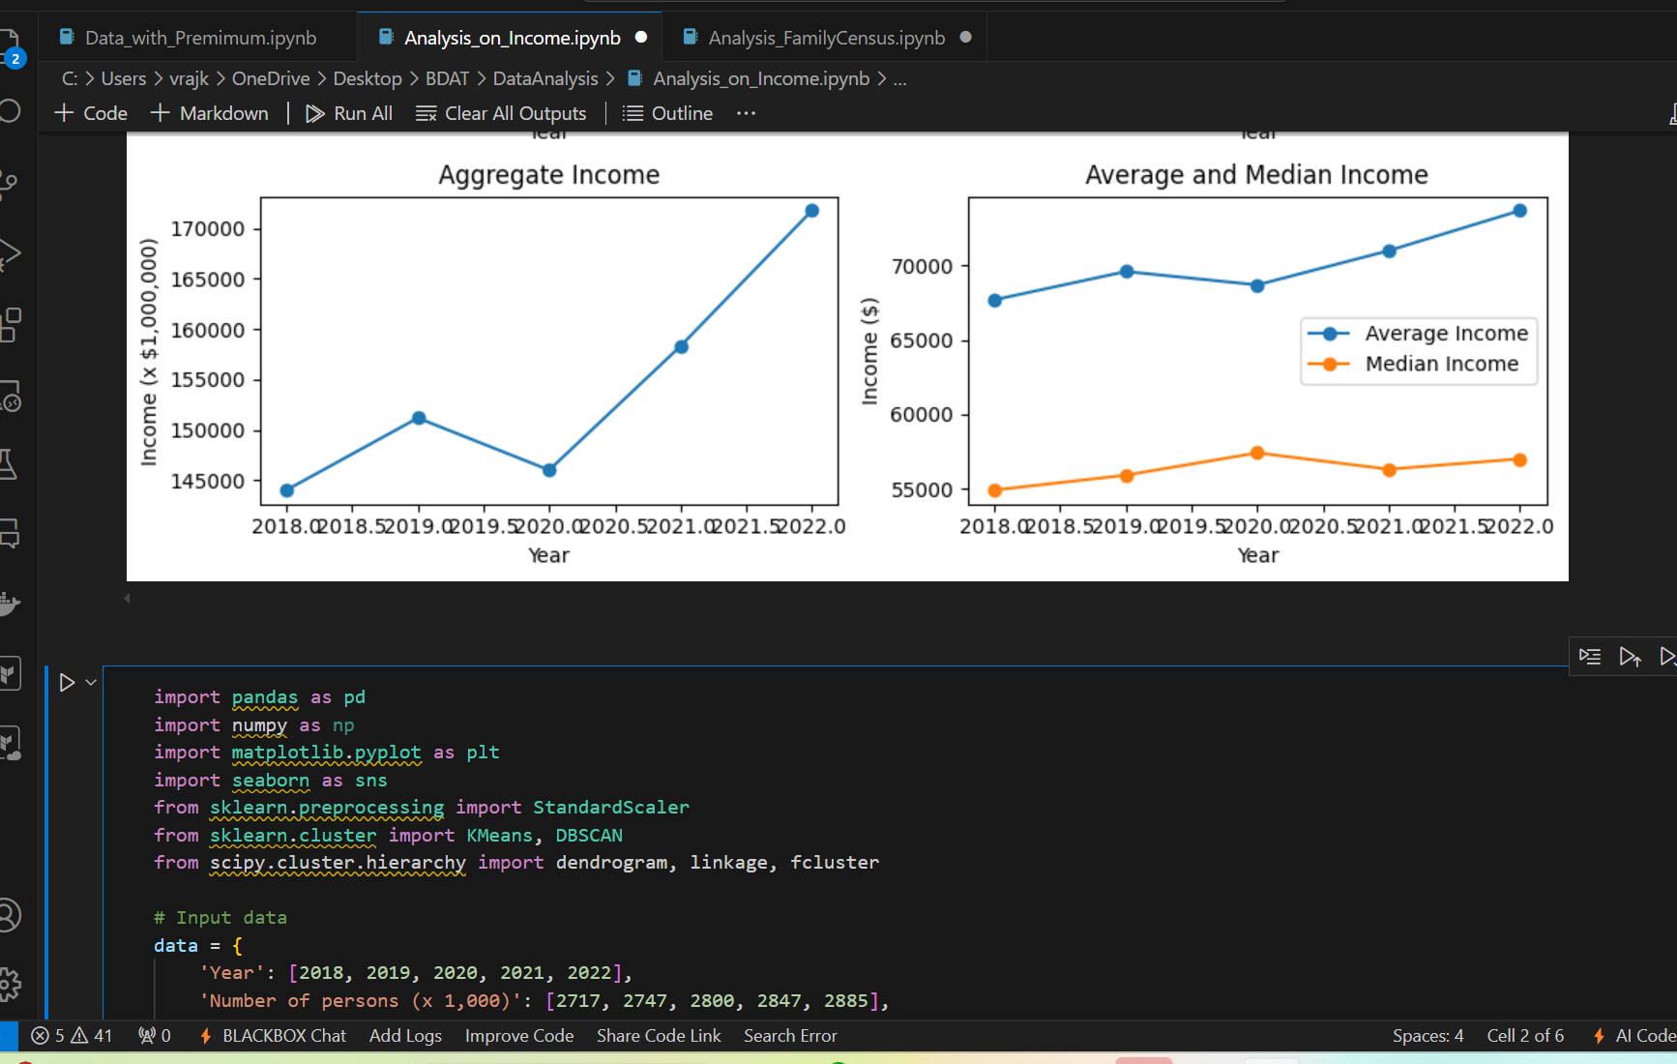
Analysis with Python (code snippets)

Slide 14
Key Analysis and Insights
1. Promising Regions
Ontario: Largest population, high economic activity, diverse demographics, making it ideal for broad marketing.
British Columbia: Leads in life expectancy, with a health-conscious population, suitable for premium products.
Alberta: Younger population and growing income levels make it a high-potential region for new insurance products.
2. Income Trends
Growth Pattern: Income consistently rose from 2018–2022, showing a stable economic trend.
2020 Dip: Likely linked to pandemic-related layoffs and reduced economic activity, emphasizing the need for flexible premium models.
Post-2020 Recovery: Significant rebound indicates resilience in targeted regions.
3. Life Expectancy
Geographic Variation: Provinces like British Columbia show higher life expectancy, correlating with better healthcare access and higher income levels.
Impact on Premiums: Longer life expectancy translates to lower risk, allowing competitive pricing in these regions.
4. Premium Calculation Factors
Age: Dominates premium determination; younger customers have lower premiums.
Income: Higher income groups can afford tailored plans, aligning with affordability tiers.
Life Expectancy: Regions with better life expectancy allow more affordable premiums.

Slide 15
Zenith Life Insurance: Strategic Insights
Regional Focus:
Ontario: Diverse demographics, focus on urban centers.
British Columbia: Health-conscious population, emphasize long-term policies.
Alberta: Younger, economically active, target entry-level premium plans.
Tailored Products:
Family-focused plans with child/spouse benefits.
Affordable individual options with flexible terms and health riders.
Flexible Pricing:
Tiered premiums based on income and life expectancy.
Age-specific discounts and dynamic adjustments for affordability.
Marketing Strategies:
Target middle-aged, high-income groups.
Regional campaigns incorporating local economic trends.
Leverage digital channels and influencers for engagement.

Slide 16
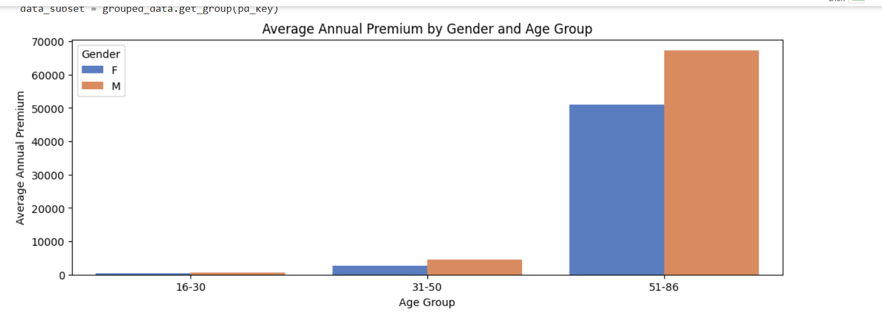
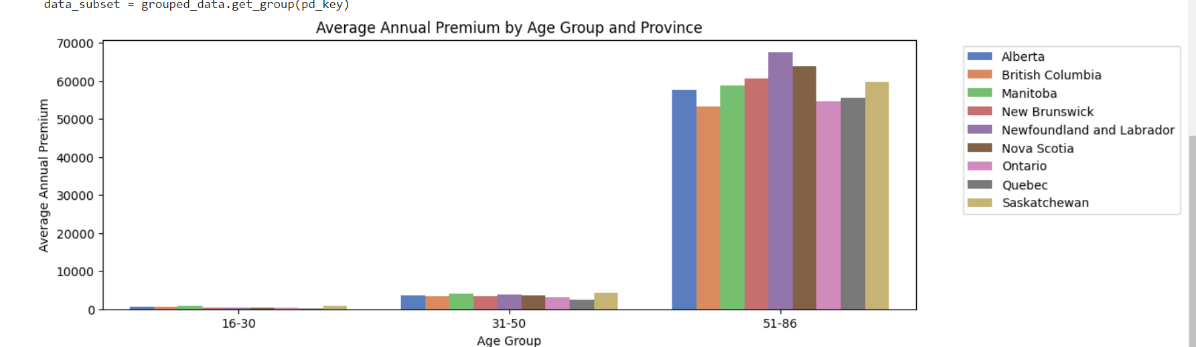
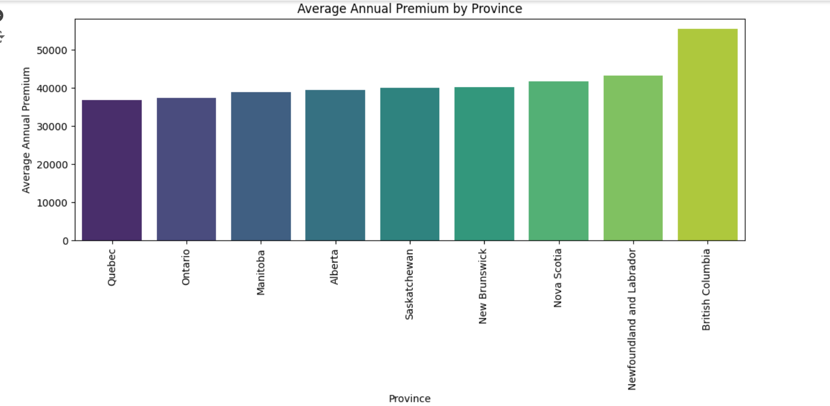
ANALYSIS OF PREMIUM AMOUNT (PYTHON)
The data indicates that British Columbia has the highest average annual life insurance premium, while Quebec has the lowest. Newfoundland and Labrador, Nova Scotia, and New Brunswick exhibit relatively higher premiums compared to Manitoba, Alberta, and Saskatchewan. Across all provinces, as age increases, so do premiums, with the 51-86 age group showing the highest rates. Males consistently have higher premiums than females, particularly pronounced in the 51-86 age group. This trend is consistent across all age groups and provinces, highlighting age and gender as significant factors influencing life insurance premiums.
16

Slide 17
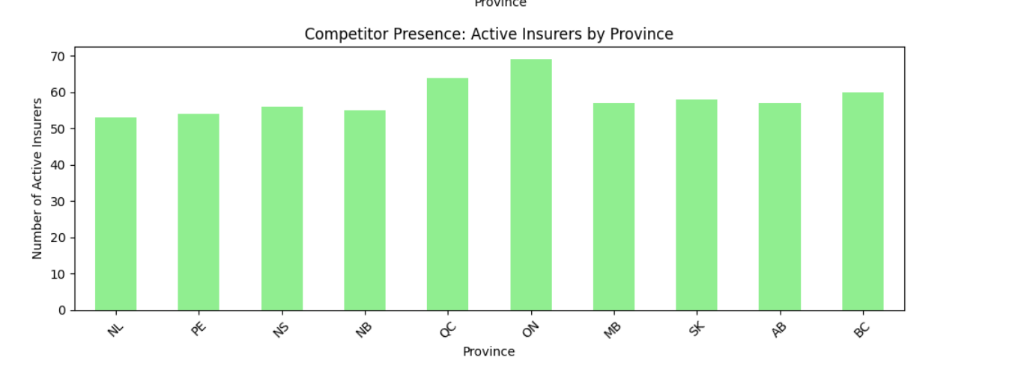
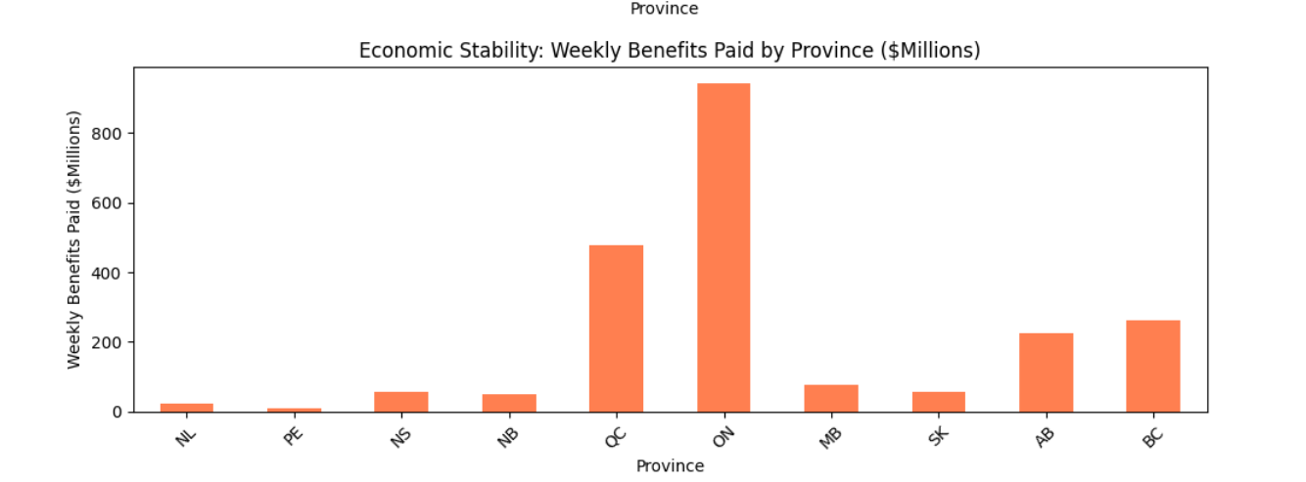
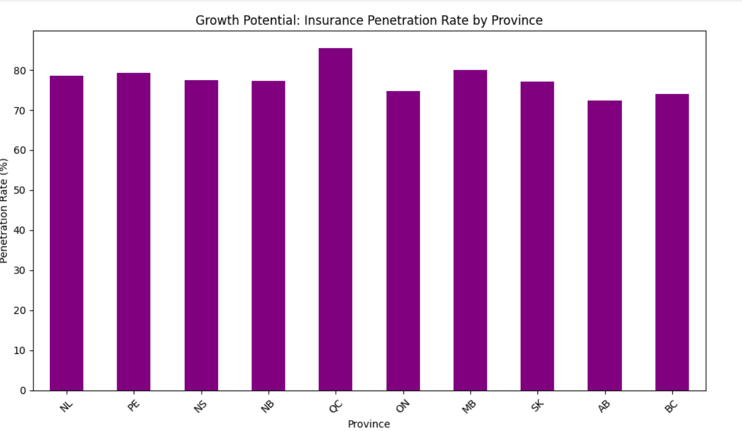
MARKET ANALYSIS (PYTHON)
Competitor Presence: Active Insurers by Province The distribution of active insurers is fairly even across the provinces, with each province hosting about 50-70 active insurers. This indicates a competitive market across all regions, suggesting that no single province is overwhelmingly dominant in terms of the number of active insurers.
Economic Stability: Weekly Benefits Paid by Province ($Millions) Ontario (ON) stands out with significantly higher weekly benefits paid compared to other provinces, followed by Quebec (QC) and Alberta (AB). These provinces have a more active insurance market in terms of payouts, indicating strong economic stability and a substantial customer base. The lower payout figures in other provinces suggest less economic activity in those regions.
Growth Potential: Insurance Penetration Rate by Province Most provinces have a high insurance penetration rate, close to 80%, indicating a mature market with extensive coverage. The high penetration rates suggest that there may be limited growth potential in increasing the penetration rate further. However, there might still be opportunities in offering more tailored or innovative insurance products to meet specific regional needs.
17

Slide 18
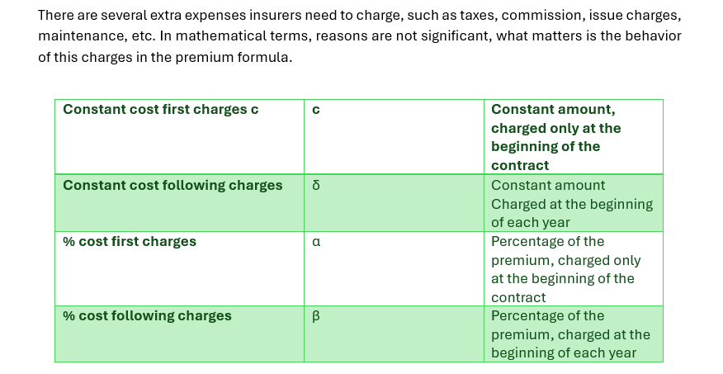
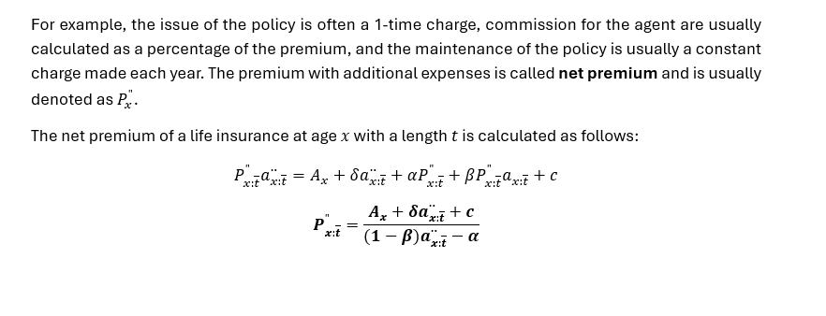
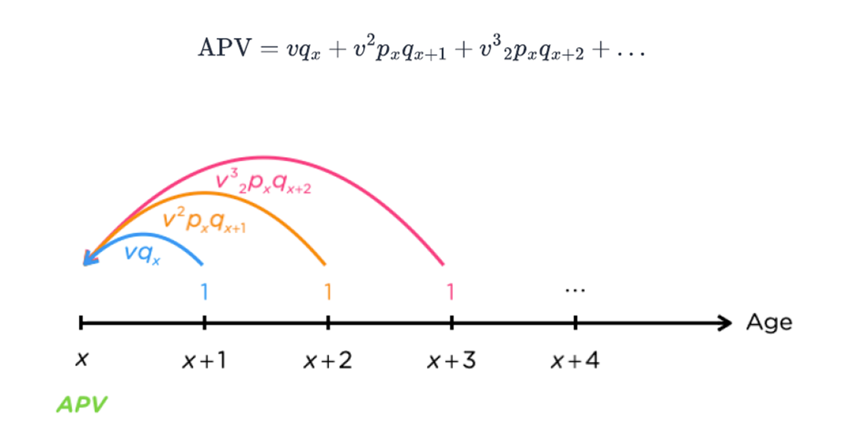
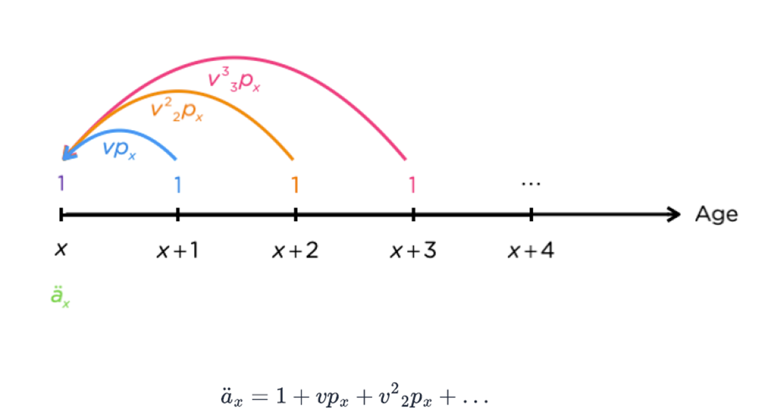
EXPLANATION OF PREMIUM AMOUNT FORMULA (MS EXCEL)

Slide 19
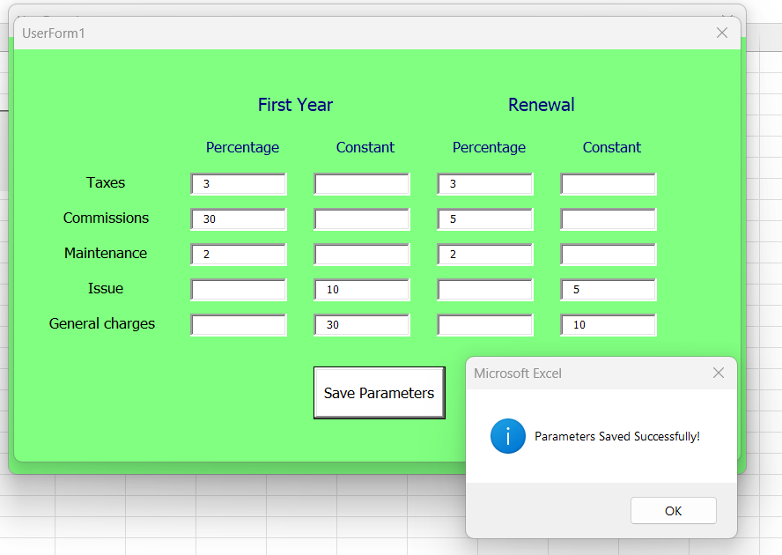
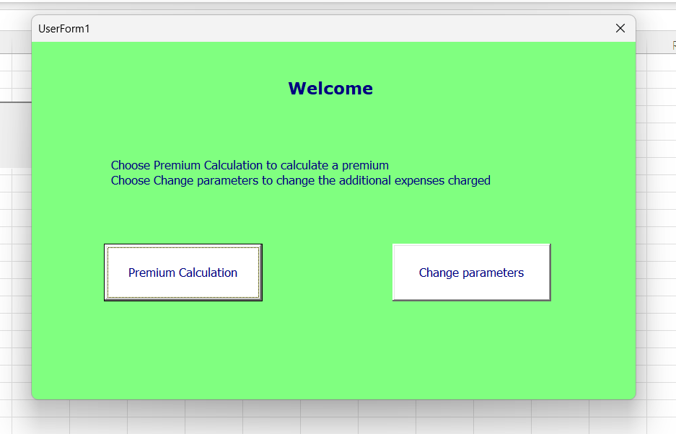
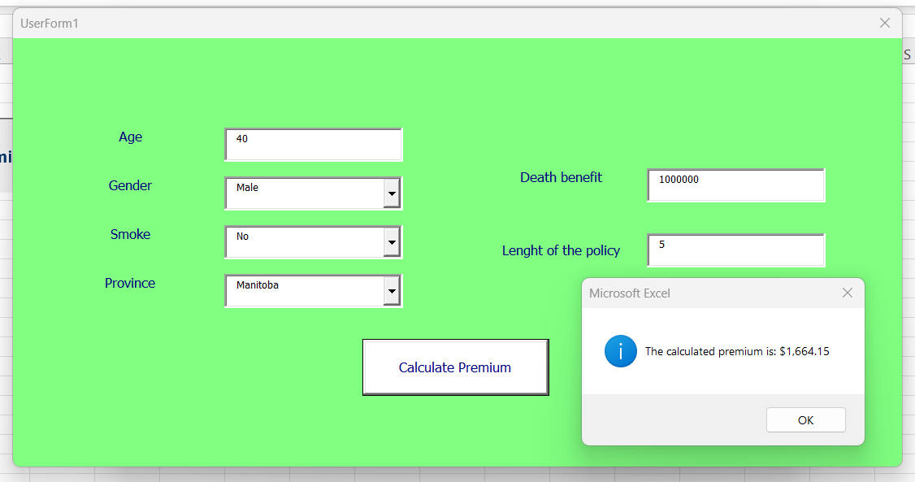
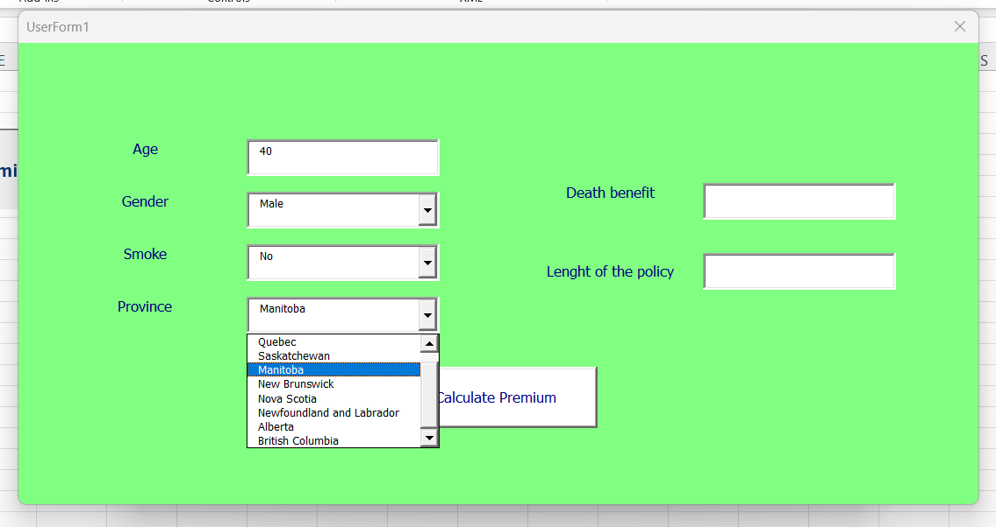
PREMIUM AMOUNT MODELING(MS EXCEL- MACROS)

Slide 20
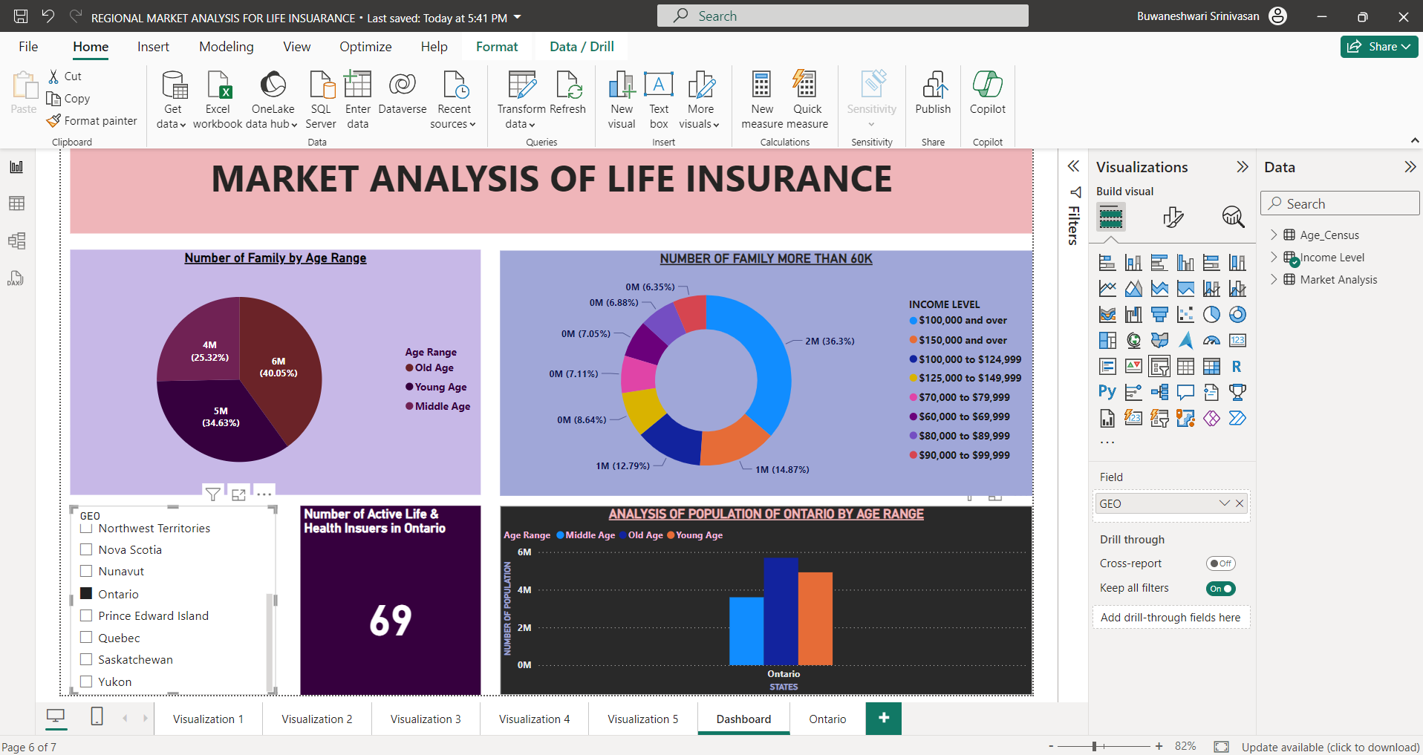
POWER BI- DASHBOARD

Slide 21
MARKET ANALYSIS (POWER BI)
Overall Insights
Ontario stands out as a key province due to its high economic activity and significant payouts, indicating a robust market.
Quebec and Alberta also show strong market potential with substantial weekly benefits paid.
Given the high penetration rates across most provinces, the focus should be on differentiating products and services rather than merely increasing market penetration.
Choosing to start the business in Ontario or Quebec would likely provide access to a large and active insurance market, though the competition would be intense. Tailored strategies to cater to the specific needs and preferences of the regions will be critical for success.

Slide 22
Lessons Learned and Recommendations
Key Challenges:
Data inconsistencies and adjustments.
Integration of work from different tools and platforms
Lessons Learned
Importance of Report: Combining insights from Excel, Python, and Power BI was essential for a comprehensive analysis.
Significance of Data Quality: Clean and well-structured data significantly impacts the accuracy of insights and model effectiveness.
Dynamic Problem Solving: Addressing challenges like missing or inconsistent data required creative solutions and reinforced teamwork.
Effective Communication: Regular team collaboration and client updates ensured alignment with project goals and timelines.
Recommendations
Expand Data Scope: Incorporate additional data sources, such as healthcare trends or lifestyle indicators, to refine premium calculations further.
Automate Processes: Implement automated workflows for data preparation and model updates to improve efficiency and scalability.
Customer Education: Use visualizations and tools to explain premium calculations transparently, building trust with clients.

Slide 23
Conclusion
This project successfully leveraged data-driven insights to analyze Canada’s diverse demographic landscape. Using Excel, Python, and Power BI, we explored key factors like age, income, and smoker status, developing a robust premium calculation model based on life expectancy dataset.
Our findings reveal actionable relationships between demographics and premiums, providing fair and competitive pricing strategies. Dynamic dashboards highlight market trends, enabling effective targeting of high-potential regions.
Deliverables, including the final report, equip Zenith Life Insurance with strategies to enhance market positioning and better serve its clientele.

Slide 24


THANK YOU

